Slide 1
Containers, Cloud Native Computing, DevOps
Oxford University
Software Engineering Programme
December 2018

Slide 2
Contents
Containers
History and Approach
Docker
Docker ecosystem
PaaS in a container model
Futures

Slide 3
Sharing of resources vs Isolation
Dedicated data centre
Dedicated HW/ Shared Datacentre
More isolation
Virtual Machines
Containers
Shared OS Separate processes
Shared
Process
Better resource utilisation

Slide 4
Lightweight Virtualization history
zSystems Virtual Servers from late 1990s
(the mainframe really did do everything first)
Solaris Containers
AIX Workload Partitions
FreeBSD Jail
…

Slide 5
What is a Container?
A lightweight virtual server
Running within an Operating System
Providing various levels of isolation and control
E.g. Disk isolation and control
Network isolation
CPU and memory controls

Slide 6
Containers at Google
Every GMail session is a container
Try doing an export and then searching your email ☺
“Everything runs in a container”
2 billion containers launched a week
Borg
Any Google developer can instantiate their code in 10,000 instances any time they want
Takes about 5 minutes to start that many
Never exactly 10,000 because of failures

Slide 7
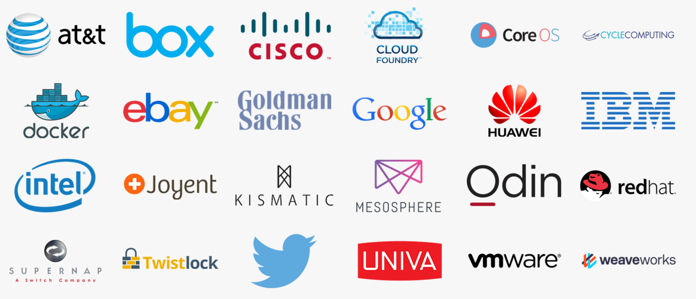
Cloud Native Computing Foundation
A new definition of “Cloud Native”
Container Packaged
Dynamically Managed
Micro-Service oriented

Slide 8
Docker on top of Containers
Docker adds several things to LXC and containerization:
Copy on write filesystem
Layered images and the ability to extend machines easily
Simple textual config file
Portable deployment across machines
Creating an ecosystem of images
Application centric
Each VM is a process (roughly speaking)
Plus others (auto-build, etc)

Slide 9
Why Docker?
The ecosystem has created a network effect
Metcalfe’s Law states
the value of a telecommunications network is proportional to the square of the number of connected users of the system
There is surely a corollary for ecosystems

Slide 10
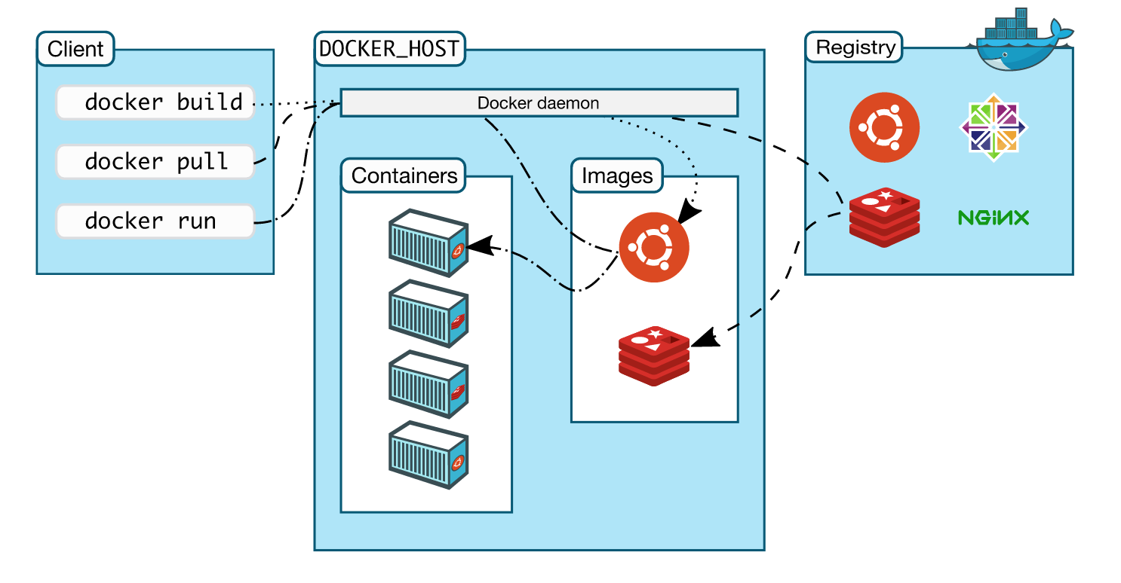
How does Docker work?

Slide 11
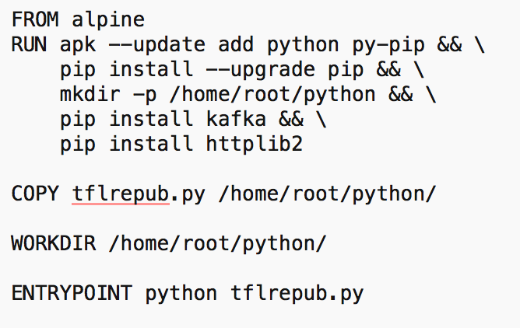
Dockerfile

Slide 12
Some simple Docker commands
apt-get install docker.io
docker pull ubuntu
docker run –t –i ubuntu /bin/bash
docker ps
docker commit funky_freo image
docker push image

Slide 13
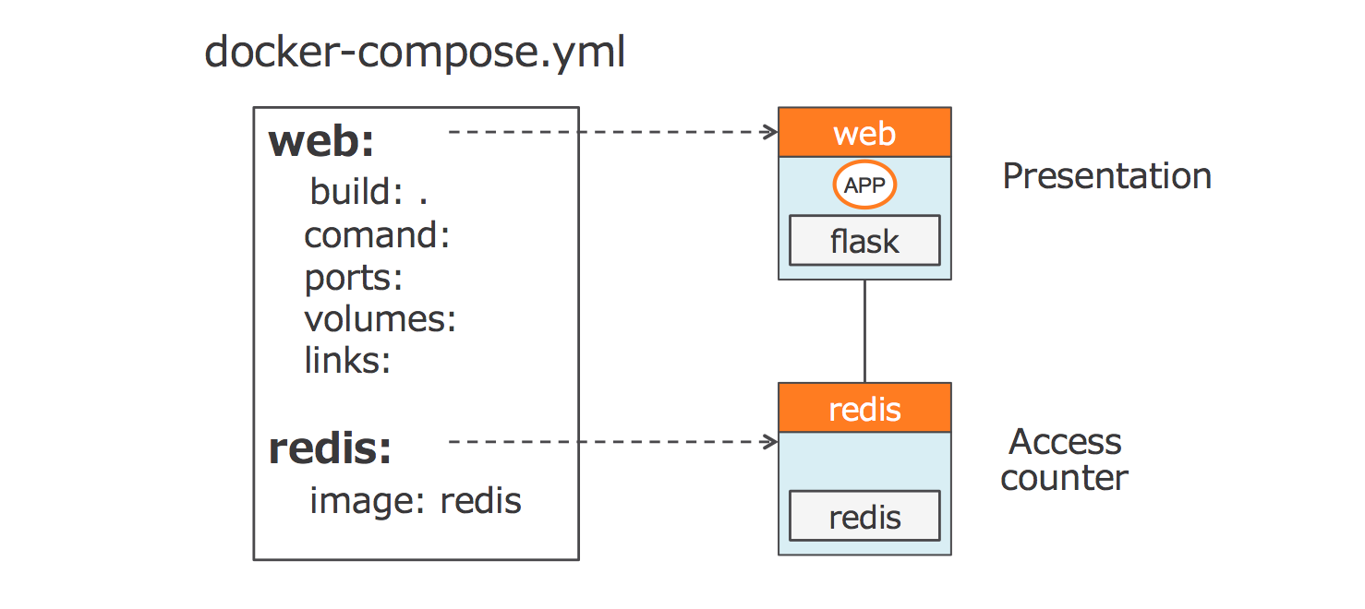
Docker Compose
How to create a set of containers that work together

Slide 14
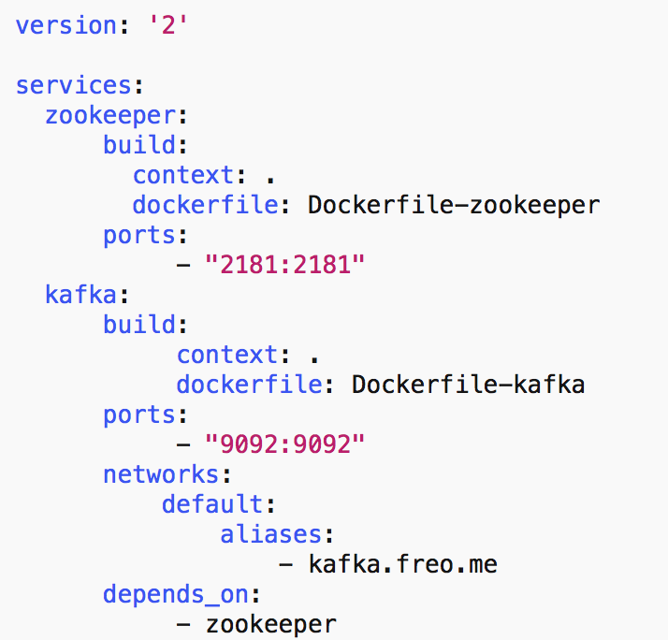
docker-compose.yml

Slide 15
Docker Machine
Manages docker servers
e.g. VirtualBox, Amazon, DigitalOcean
Let’s you start/stop and configure Docker to talk to the remote server

Slide 16
Quick demo

Slide 17
Cloud Orchestration
What does an Operating System do?
Manages processes
Co-ordinates the processes access to resources
CPUs
Memory
Disk
Devices
Fairness and priority between processes

Slide 18
Datacenter Operating System aka Container Orchestration
Manages the placement of containers
Access to resources
Configuration and networking
Moves containers
Load balances across containers
Effectively creating a single OS across a cloud
Containers vs Processes

Slide 19
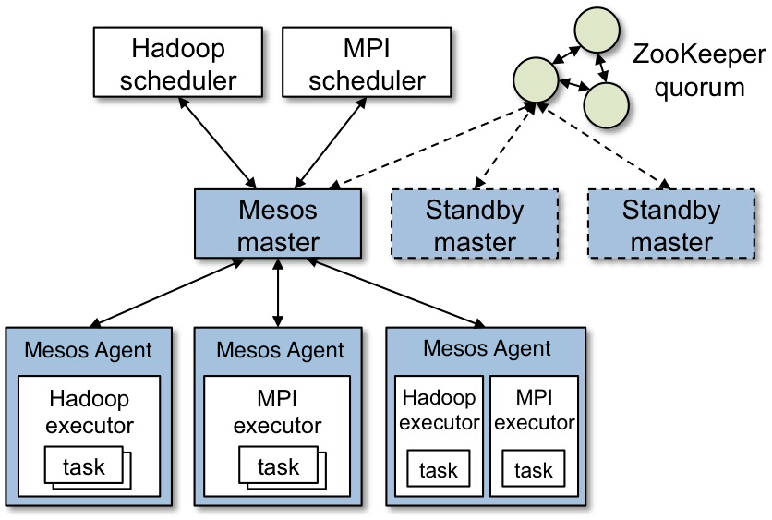
Apache Mesos

Slide 20
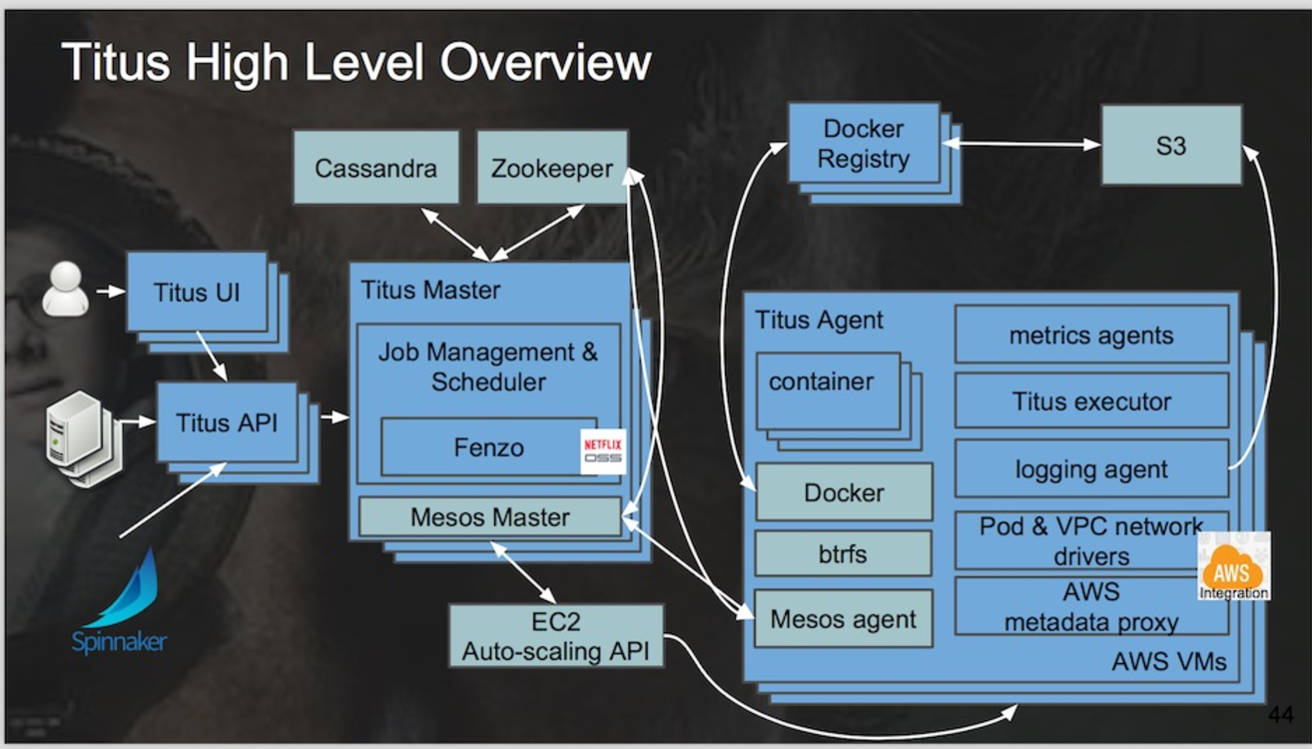
Netflix Titus
Running on 5000 AWS instances (m4.4xlarge and r3.8xlarge) Three regions
10,000 containers running at any time
1,000,000 containers launched
https://www.infoq.com/news/2017/07/netflix-titus

Slide 21
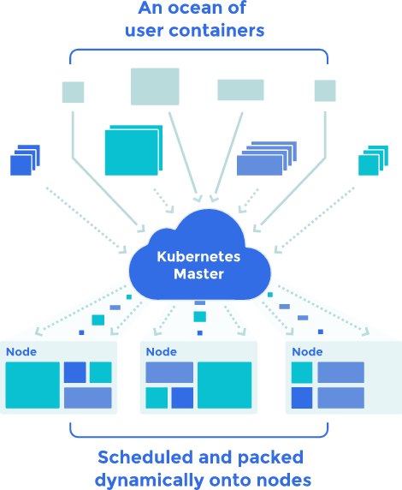
Kubernetes
Open Source cluster management of containers
From Google, but separate from the Borg project

Slide 22
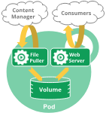
Pods
A Pod encapsulates an application container (or, in some cases, multiple containers), storage resources, a unique network IP, and options that govern how the container(s) should run.
A Pod represents a unit of deployment: a single instance of an application in Kubernetes, which might consist of either a single container or a small number of containers that are tightly coupled and that share resources.

Slide 23
Services
An abstract exposure of pods
Pods die and are recreated, replicated
“A Kubernetes Service is an abstraction which defines a logical set of Pods and a policy by which to access them”

Slide 24
Volumes
A persistent virtual disk that belongs to a Pod
Shares data between containers
Lives longer than a container, but no longer than the pod

Slide 25
Namespaces
A virtual cluster
Names must be unique inside namespaces, can be the same across different namespaces

Slide 26
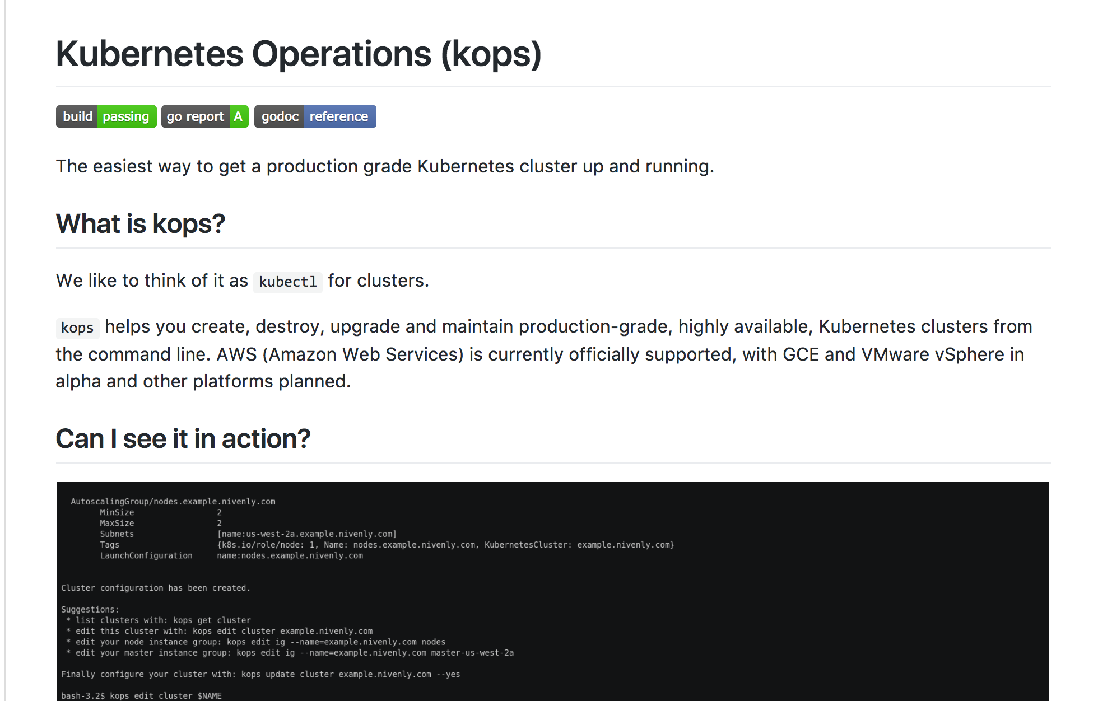
KOPS

Slide 27
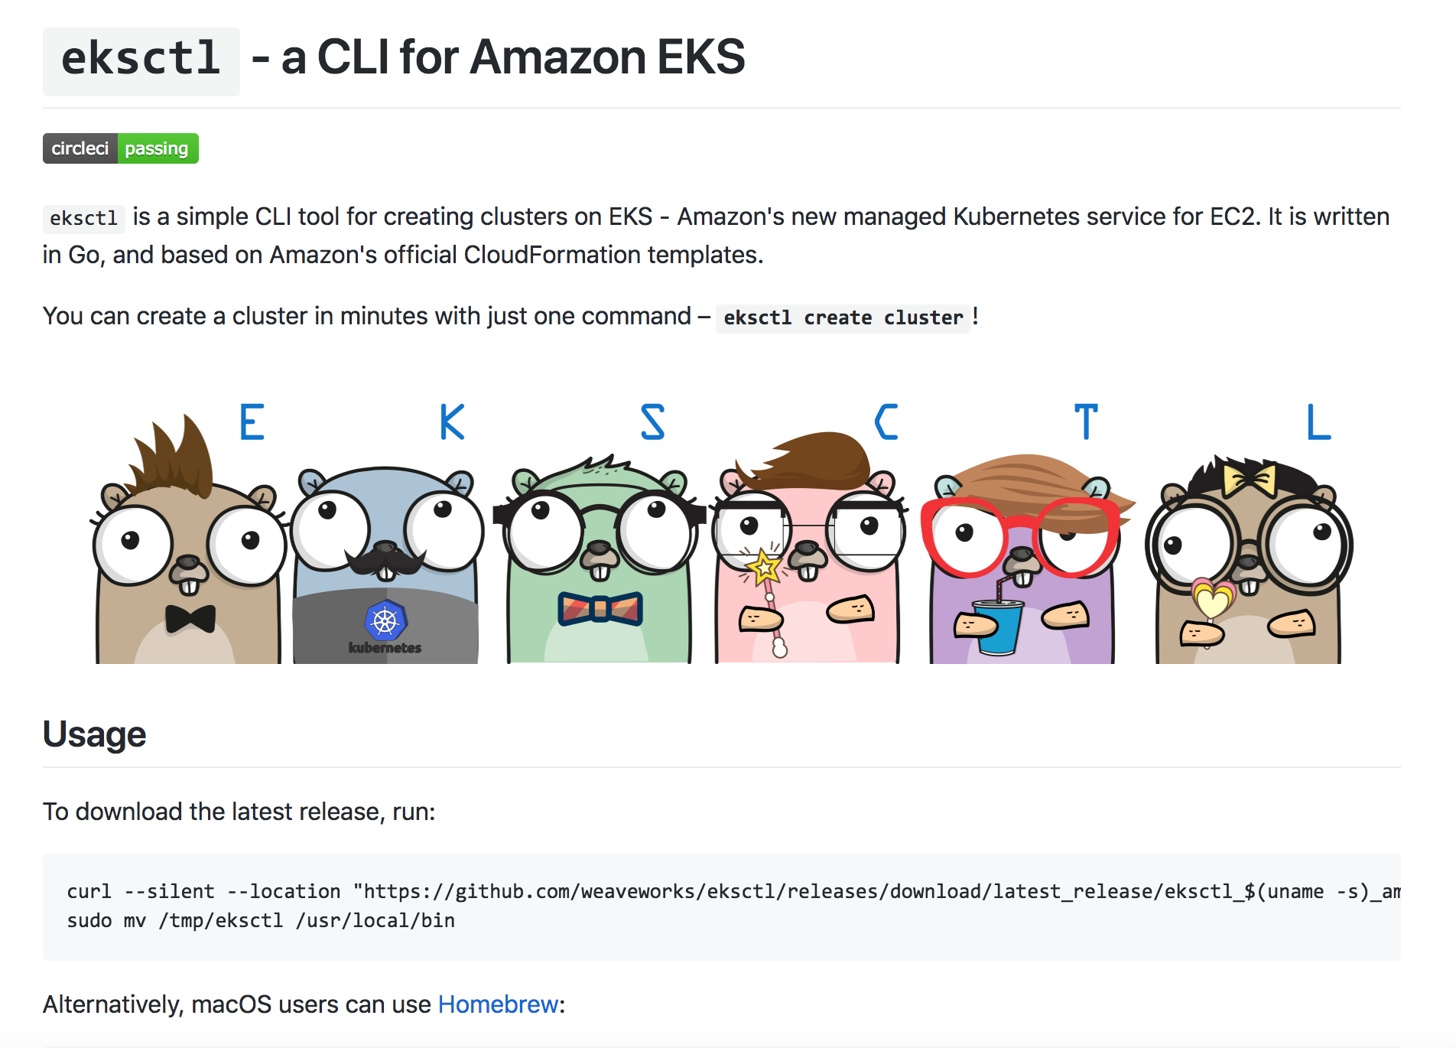
eksctl

Slide 28
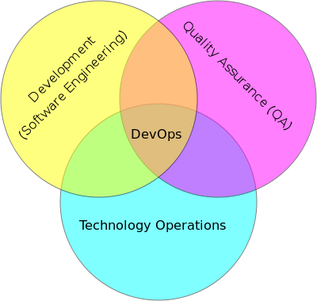
DevOps

Slide 29
DevOps
DevOps is the codification of the interface between Development and Operations
Agile
Repeatable
Collaborative
Versioned
Automated

Slide 30
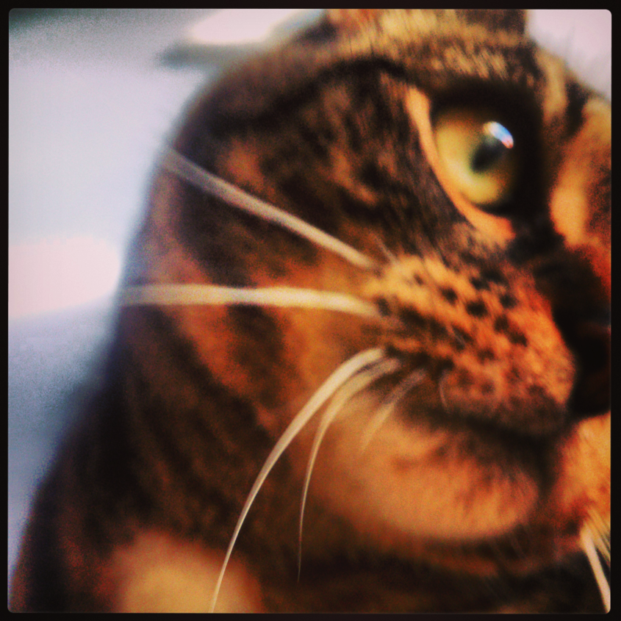
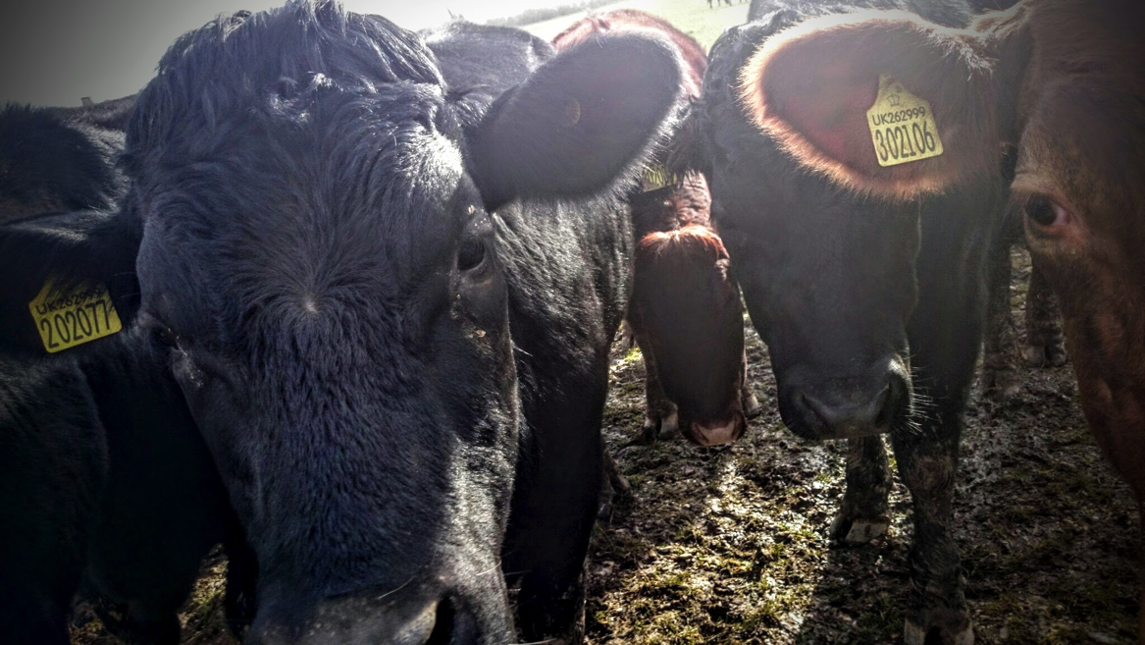
Kittens vs Cattle (An unpleasant but effective analogy)

Slide 31
Immutable objects
String in Java
You can’t change a String, only create a new one
Applies to devops:
Never change a running server
Only create a new one that is better
Track the changes in a version control model

Slide 32
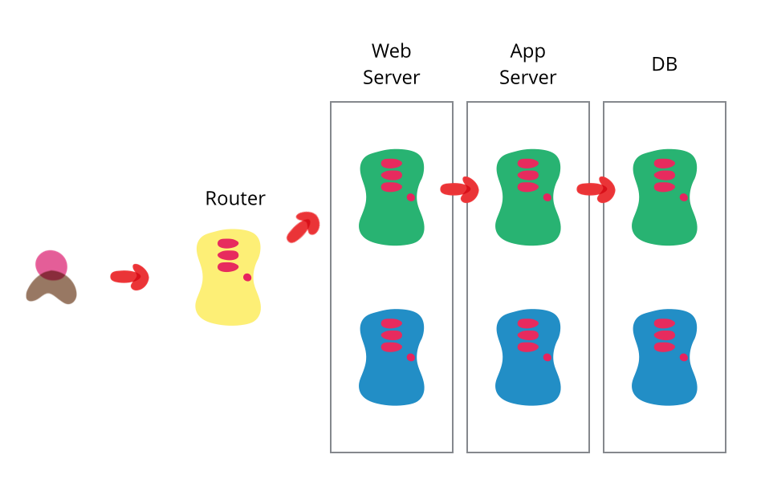
Blue Green Deployment
http://martinfowler.com/bliki/BlueGreenDeployment.html

Slide 33
DevOps tools
Puppet, Chef
Automated configuration and deployment tools
Allow complex infrastructures to be re-configured automatically
Vagrant
Create VMs instantly
Plus many many more!

Slide 34
DevOps and Docker
Docker is a key DevOps tool
Speeds up the creation of repeatable deployments
Consistency between development, test and production
Versioned repository
Works with Chef, Puppet, etc

Slide 35
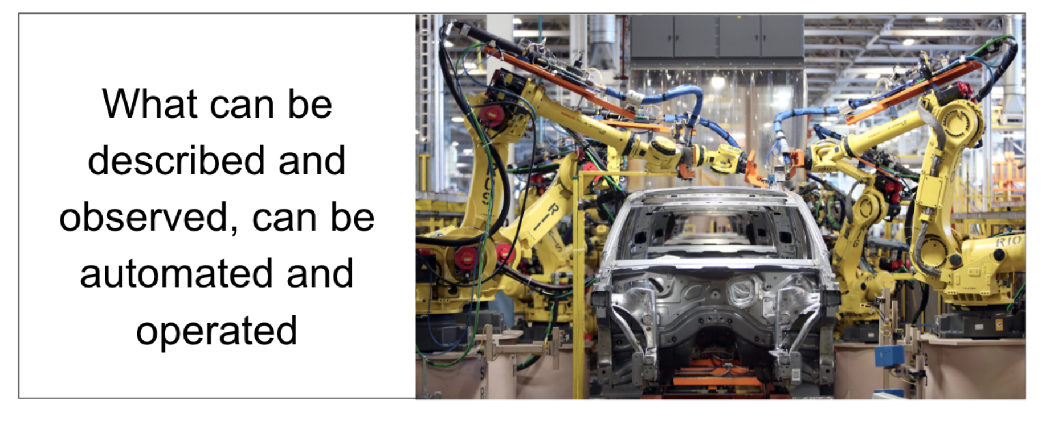
https://www.weave.works/blog/gitops-git-push-all-the-things

Slide 36
GitOps
Infrastructure as Code
Terraform + Deployment + Containers + Build
Everything is in Git
Any change to the infrastructure is a Pull Request

Slide 37
Summary
Docker and the Container model
Lightweight virtualization and repeatability
Blue Green deployment
“Warehouse Scale” computing

Slide 38
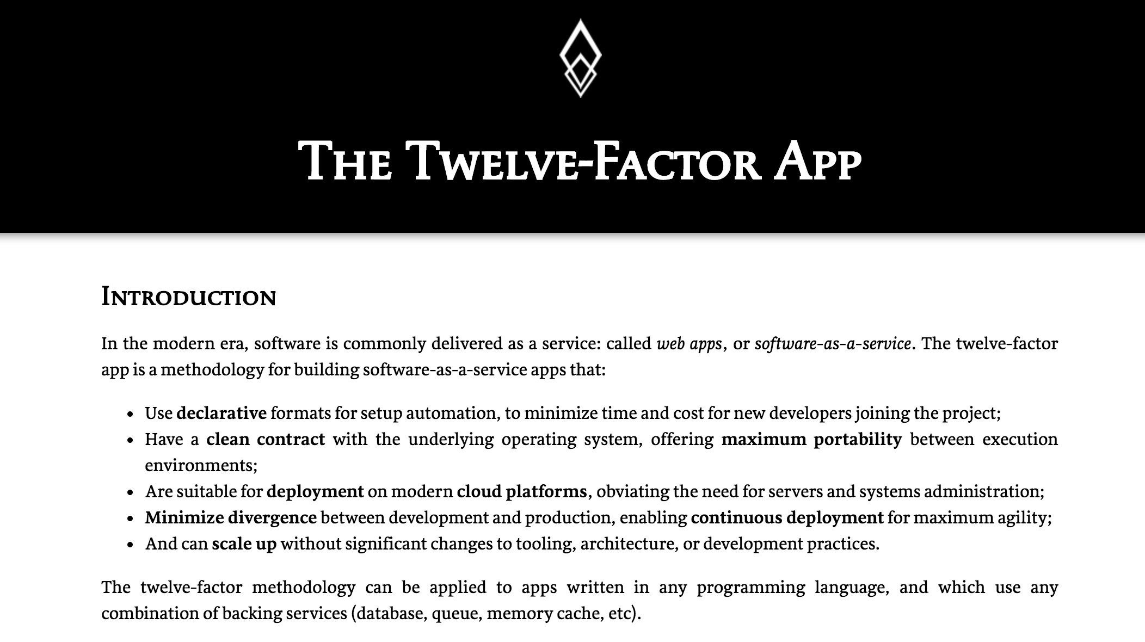
http://12factor.net

Slide 39
12 Factor Apps
Codebase
One codebase in revision control, many deploys
Dependencies
Explicity define and declare
Config
Store config in the environment
Backing Services
Treat as attached resources
Build, Release, Run
Strictly separate
Processes
Execute the app as stateless processes
Port Binding
Export services via port binding
Concurrency
Scale out via processes
Disposability
Fast startup and graceful shutdown
Dev/Prod Parity
Keep dev/staging/prod as similar as possible
Logs
Treat logs as event streams
Admin Processes
Run admin/mgmt tasks as one-off processes

Slide 40
Summary
Docker and the Container model
Lightweight virtualization and repeatability
Blue Green deployment
“Warehouse Scale” computing

